Slide 1



Infrastructure Overview
Azure Cloud Environment
Virtual Network
Availability Zone A
Workspace
License Server
Web
Server1
App
Server1
Azure SQL
Network Load Balancer
Application Load Balancer
Browse
Desktop client
App
Server2
Web
Server2
Printers
Availability Zone B
Laptop Server
Shared
Instrument Files

Slide 2
Infrastructure Overview
Application Layer
The primary server contains all instance files, and the work servers only contain the Exe and Logfile folders necessary for the program. Other files are shared with the primary server.
Additional pods are deployed within the Azure, including
SM Sync – Real-time synchronizes Exe folder files across all SampleManager nodes
Shared Folder - Creating a shared folder for instance resource files
Underlying compute resources scale horizontally to accommodate the customer-requested number of concurrent users.
All users log in to the system through load balancer.
Application Subnet – Private
Primary App Server
Work App Servers

Slide 3
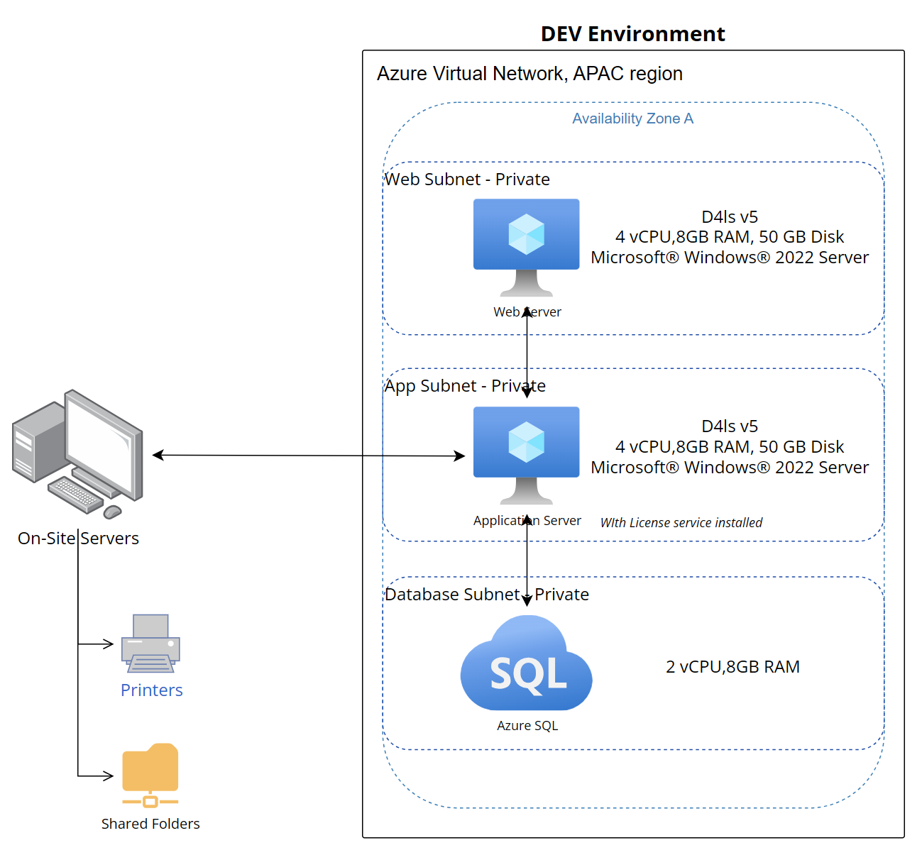
DEV Environment
The development environment is mainly used for system development and configuration. It does not require high availability and only needs to meet regular development requirements, such as a Windows environment, network and required ports are opened to each other.
The database used in the development environment can be the underlying Azure SQL database or other types of databases supported by the product, such as Oracle and Postgres.
To connect to the local printers and collect local instrument result files, we need to set up a server locally. There are no specific requirements for the server spec, and a common laptop could be enough.

Slide 4
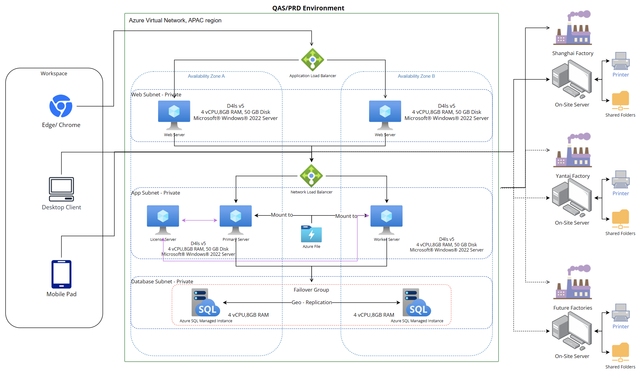
QAS and PRD Environments
To ensure the reliability of the test results, we recommend setting up the same environment for test environment(QAS) as production environment(PRD).
Considering the requirement for continuous running of the PRD environment, we need to consider the high availability of the system:
Achieve high availability of web and application servers by configuring load balancing of servers in two different availability zones
Achieve high availability at the database level by using Azure SQL Managed Instance
For the resource file sharing mentioned before, it can be achieved through SMB Azure file, and the shared file folder can be mounted on each application server. We can also use Azure file in combination with Azure file sync service to synchronize the exe folder in the instance file on the local disk of application servers.
Combined with the current number of concurrent users, it is completely sufficient to temporarily set up 2 application servers. When other factories continue to join in the future, we can consider adding more worker servers under load balancing to meet performance requirements.
Set up a separate license server to achieve license sharing between different factories. In the future, it is possible to consider placing the license server in Europe or other regions with a large number of users.
Each factory has a separate on-site server to facilitate the factory to manage the printers and instrument result files of each factory separately.
By the way, as my understanding, the mobile terminal can only use the SampleManager Mobile app. The browser version of the mobile terminal is not in the list of compatible software for the web client, so the web server cannot be accessed on the mobile terminal.

